Slide 1

Credit Card Fraud Detection
CP630 OC Final Project
Fall 2024
Wai Kei LAI 225846250

Slide 2

Table of Content
Session 1 – Problem and Proposed Solution
Session 2 – Conceptual and Physical Design
Session 3 – API and UI Demo
Session 4 – Feature Highlights
Session 5 - Dataset Conversion and Data Pipeline

Slide 3
Session 1
Problem and Proposed Solution

Slide 4
Problem Identified
Option Consommateurs (2024) published a report which showed that around 30% of the Canadians remember themselves being a victim of the bank fraud.
The classical approaches are being done on manual basis and most times more rules limits systems, is becoming more obsolete not because such systems are not in existence but because the fraud depots have become more advanced in their tactics.
Various machine learning techniques have been proposed for fraud detection. One such technique involves the use of LightGBM for Credit Card Fraud Detection (Huang,2020).

Slide 5
Project Objectives
Dataset Acquisition
Data Review and Mapping
AI Model Development
Transaction Validation
Notification of Customer

Slide 6
Session 2
Conceptual and Physical Design

Slide 7
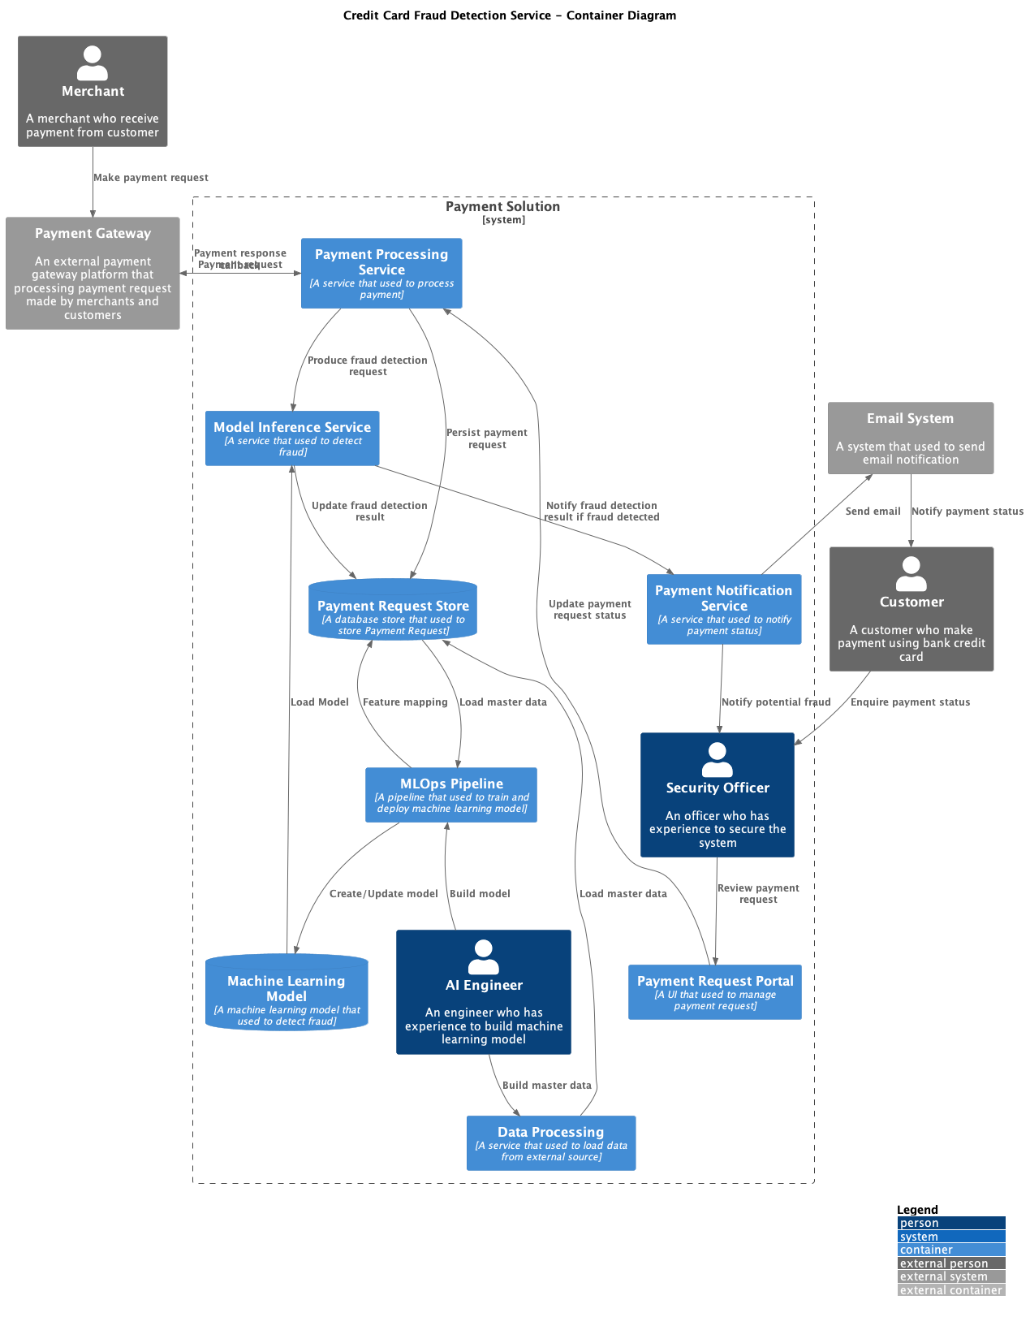
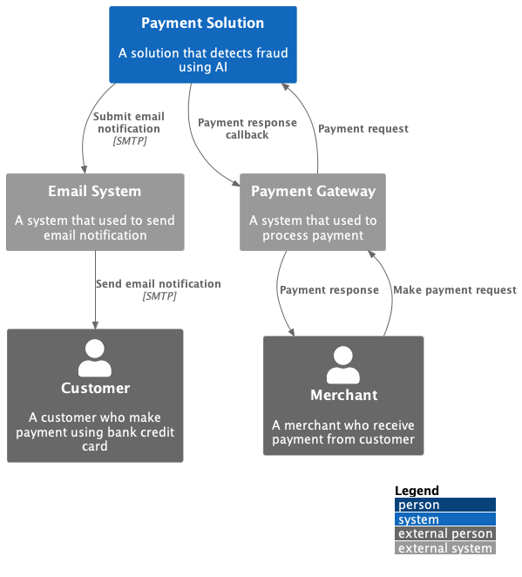
Context and Container Diagrams

Slide 8
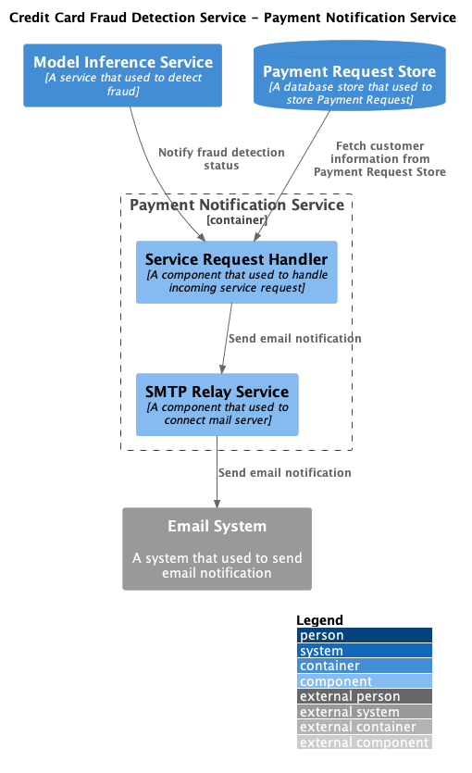
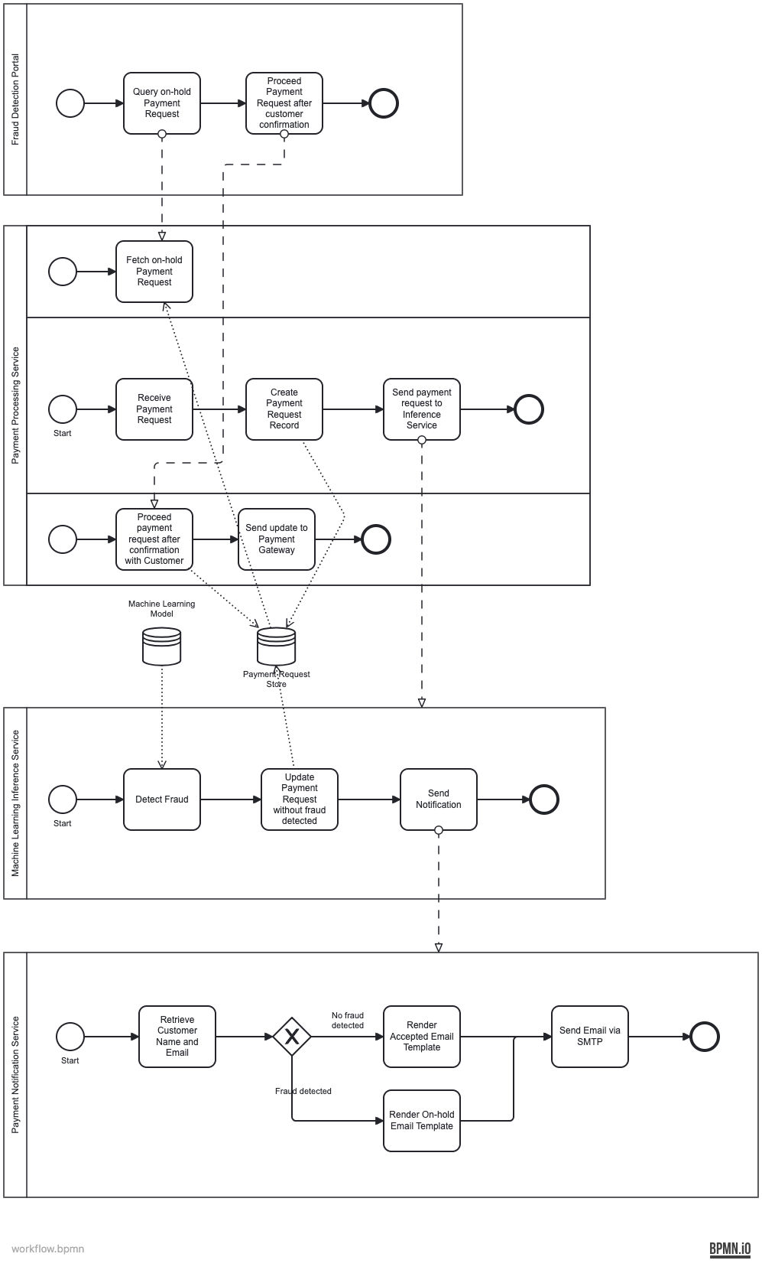
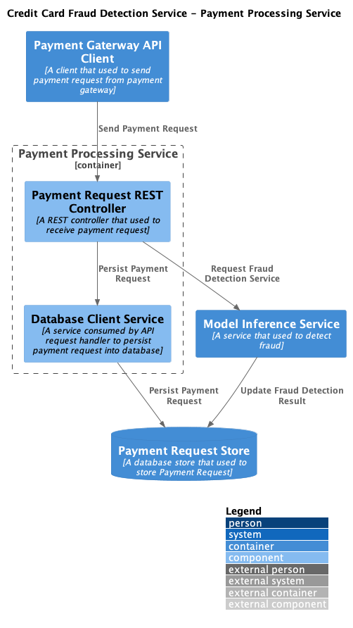
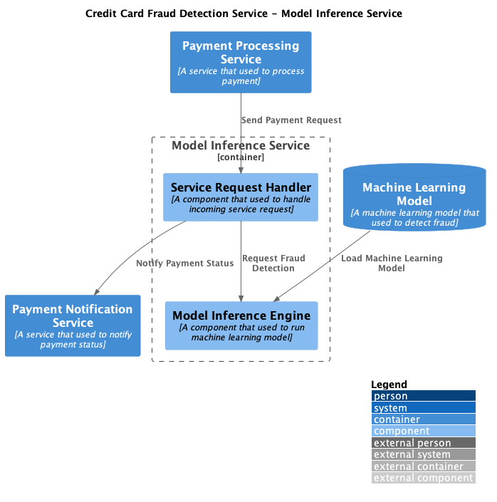
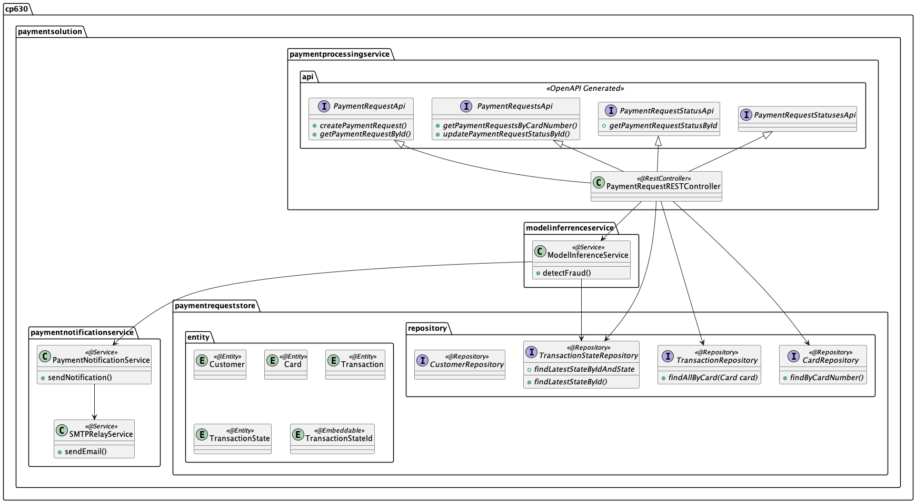
Component Diagrams to Workflow & Class Diagram

Slide 9
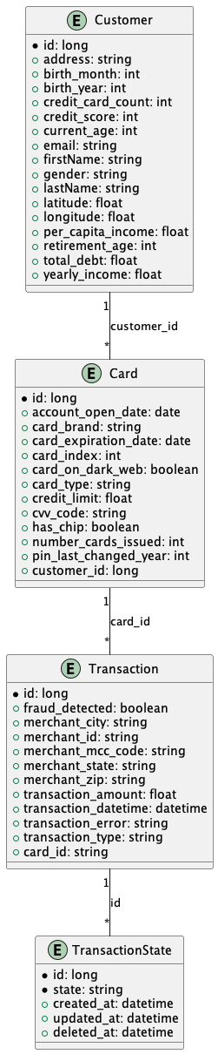
Data Model to SpringBoot Entity Classes
Customer entity class
Card entity class
Transaction entity class
TransactionState entity class
cp630.paymentsolution.paymentrequeststore.entity

Slide 10
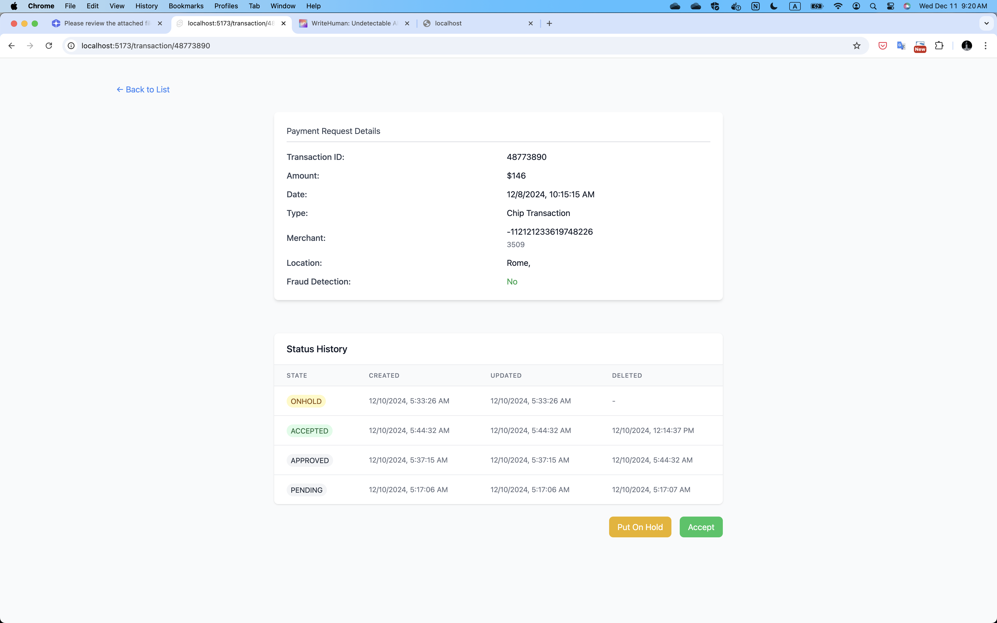
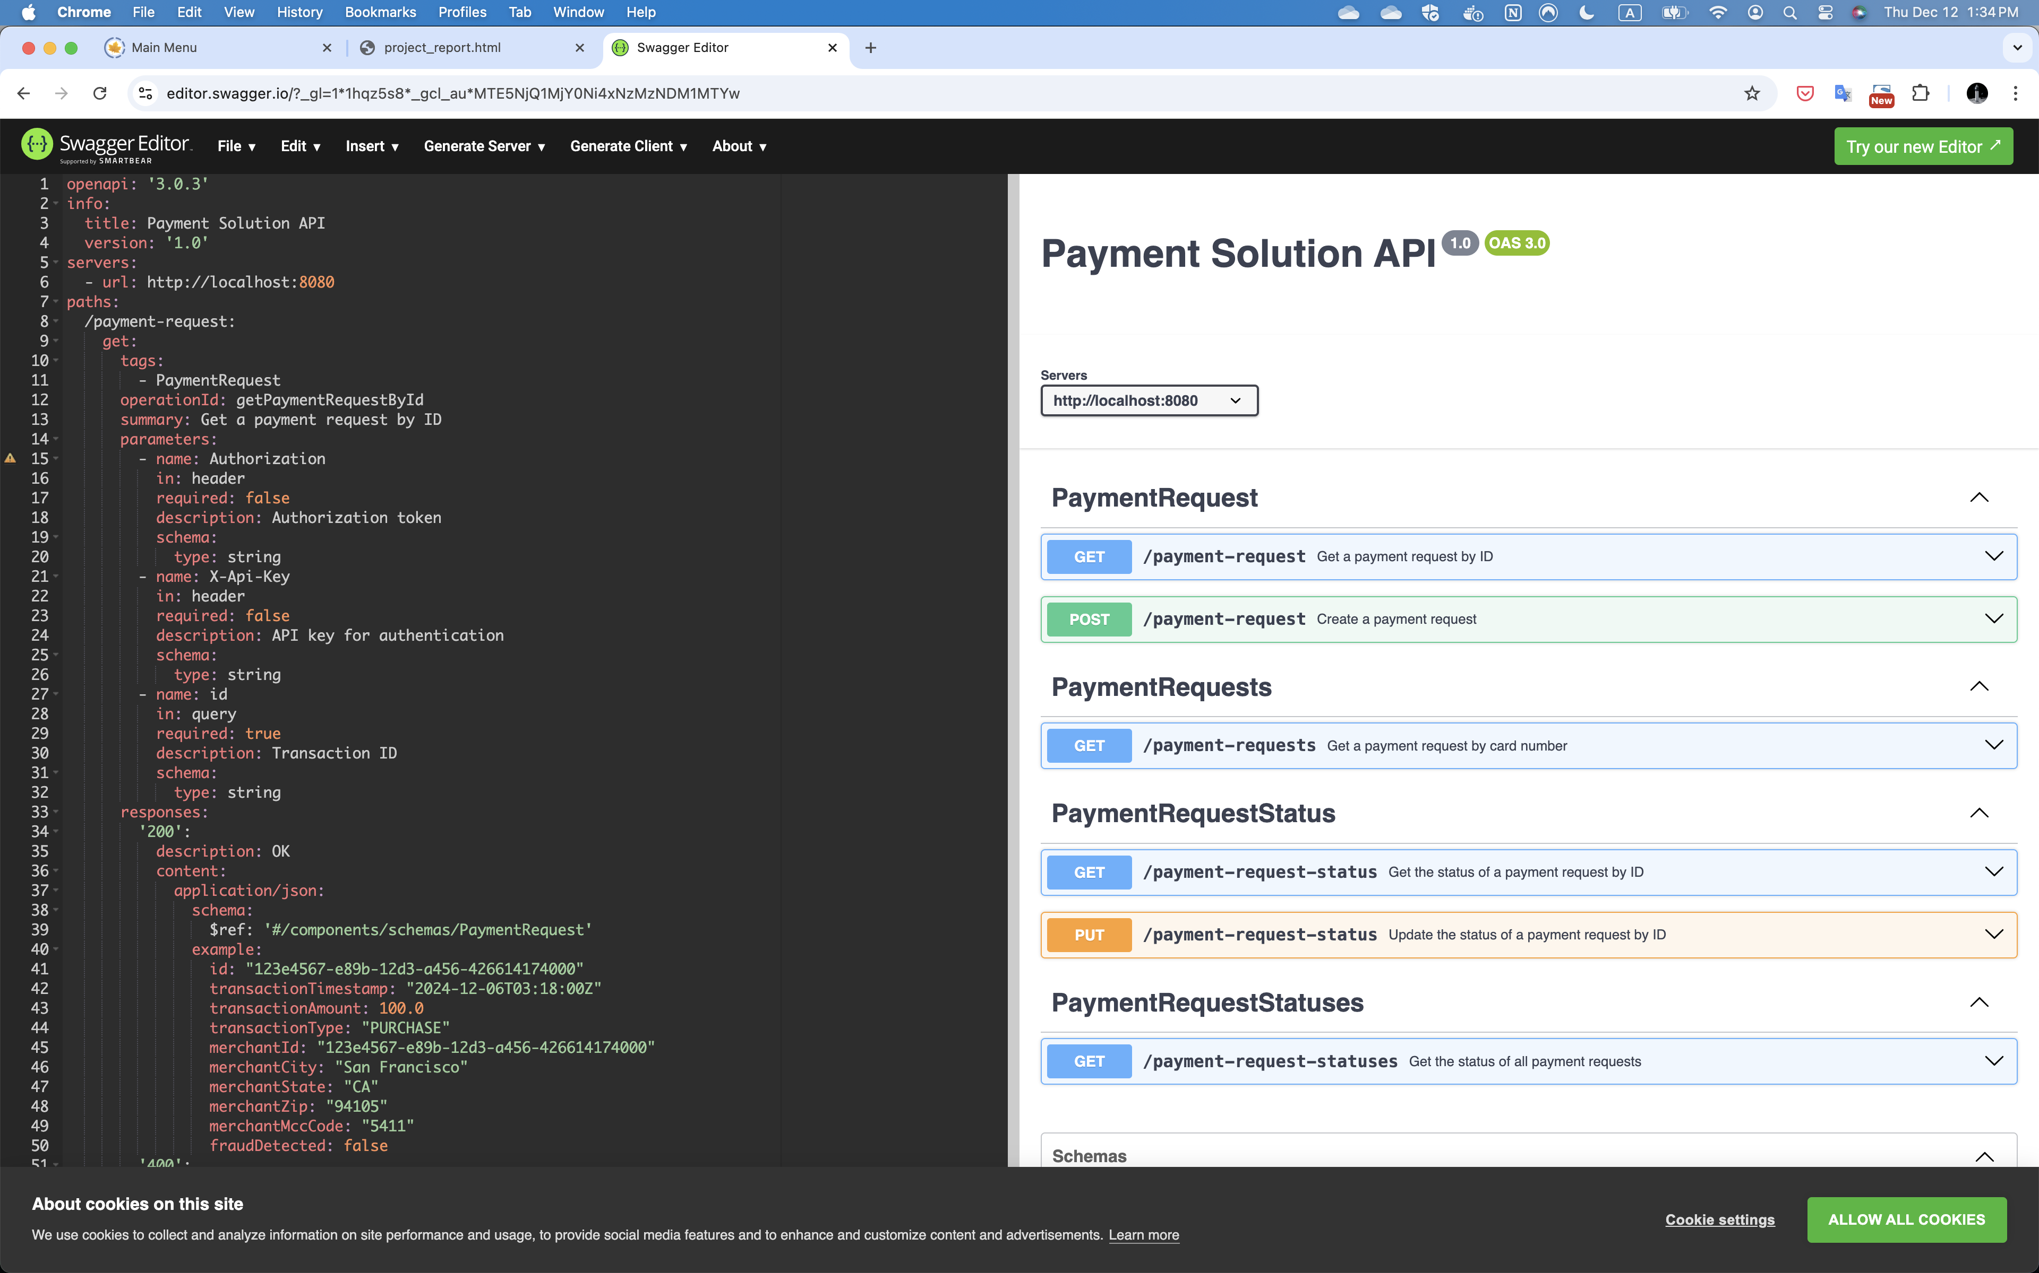
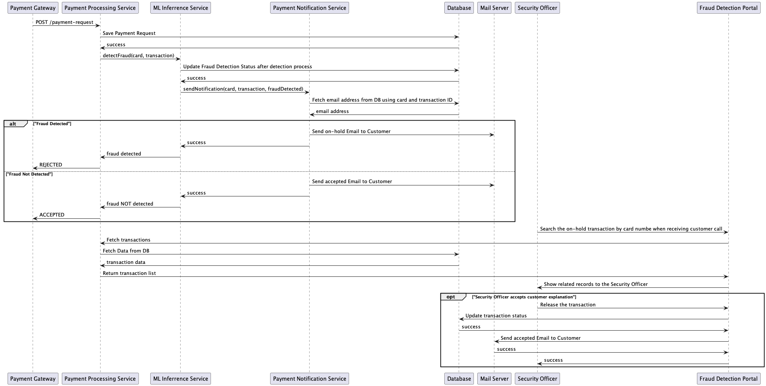
Workflow+Sequence Diagram to UI and OpenAPI Specification

Slide 11

Session 3
API and UI Demo

Slide 12

Session 4
Feature Highlights

Slide 13

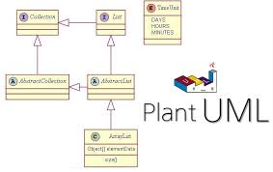

Design Tools

Slide 14
UX Driven API Design

Slide 15
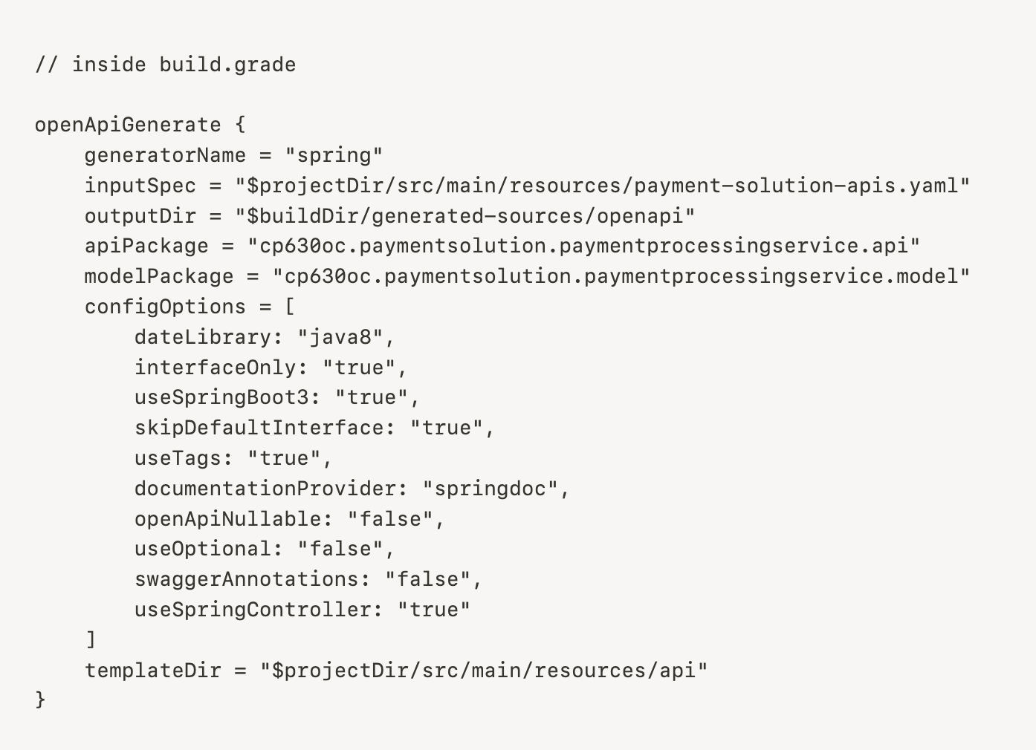
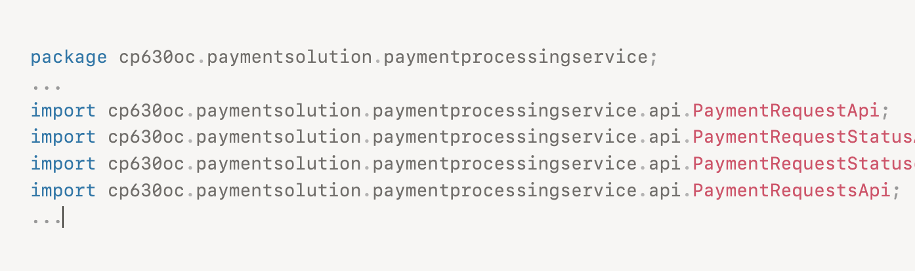
OpenAPI Generator

Slide 16
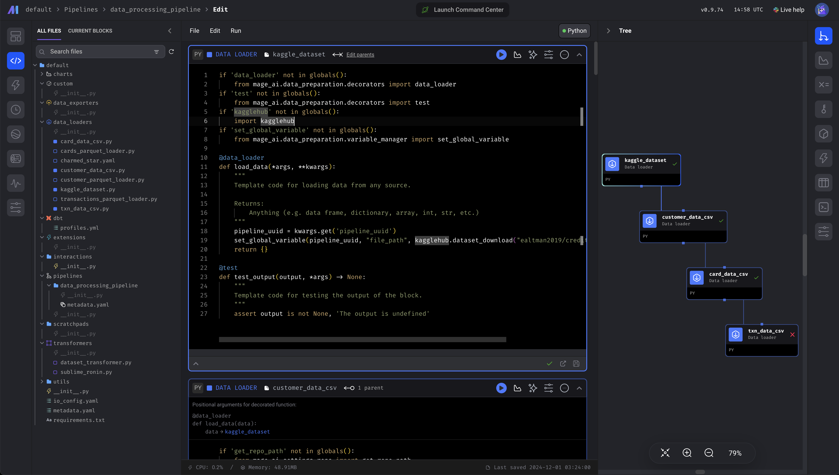


Mage.AI Codeless MLOps Tool

Slide 17
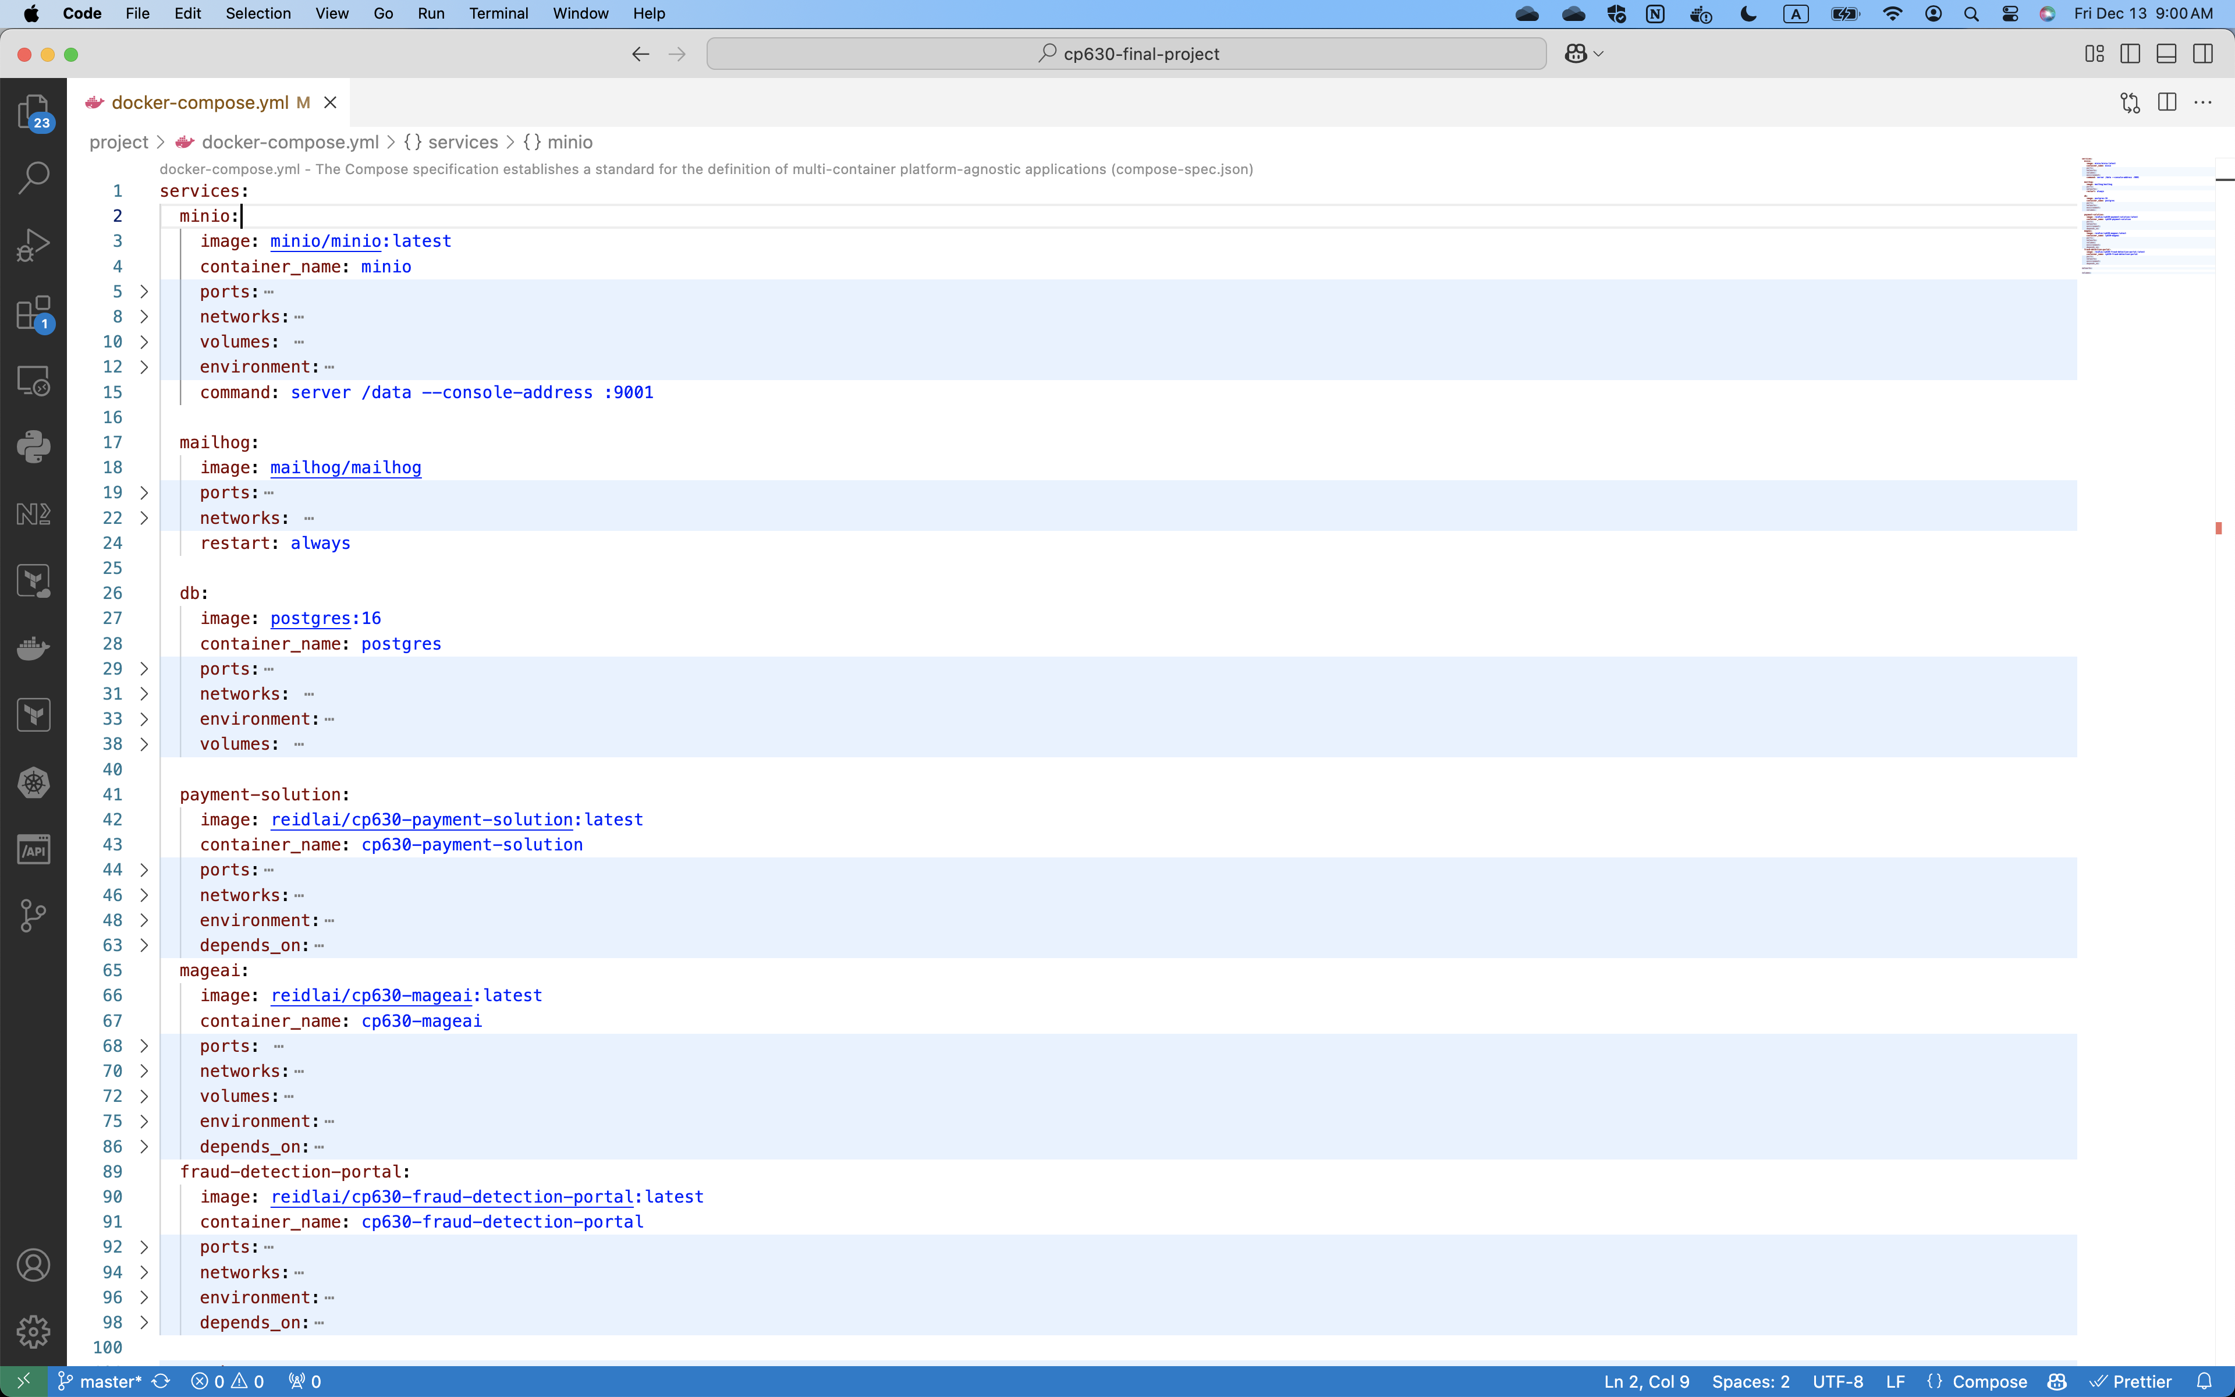
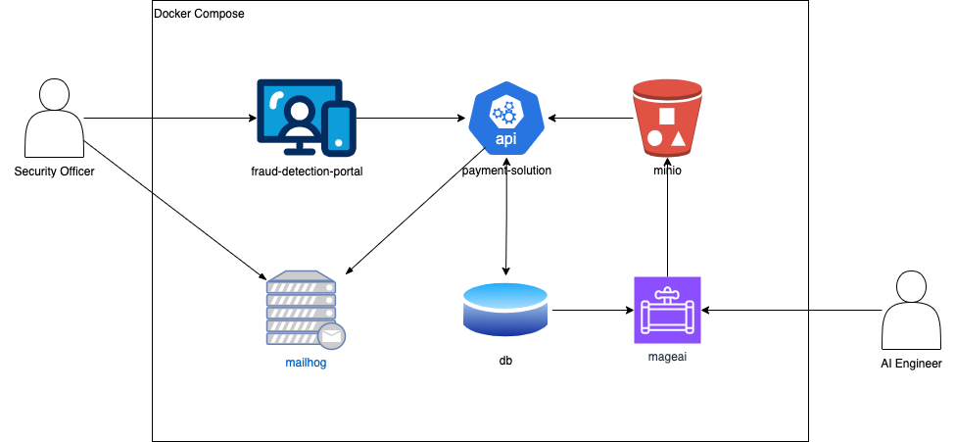
Deployment

Slide 18

Session 5
Dataset Conversion and Data Pipeline

Slide 19
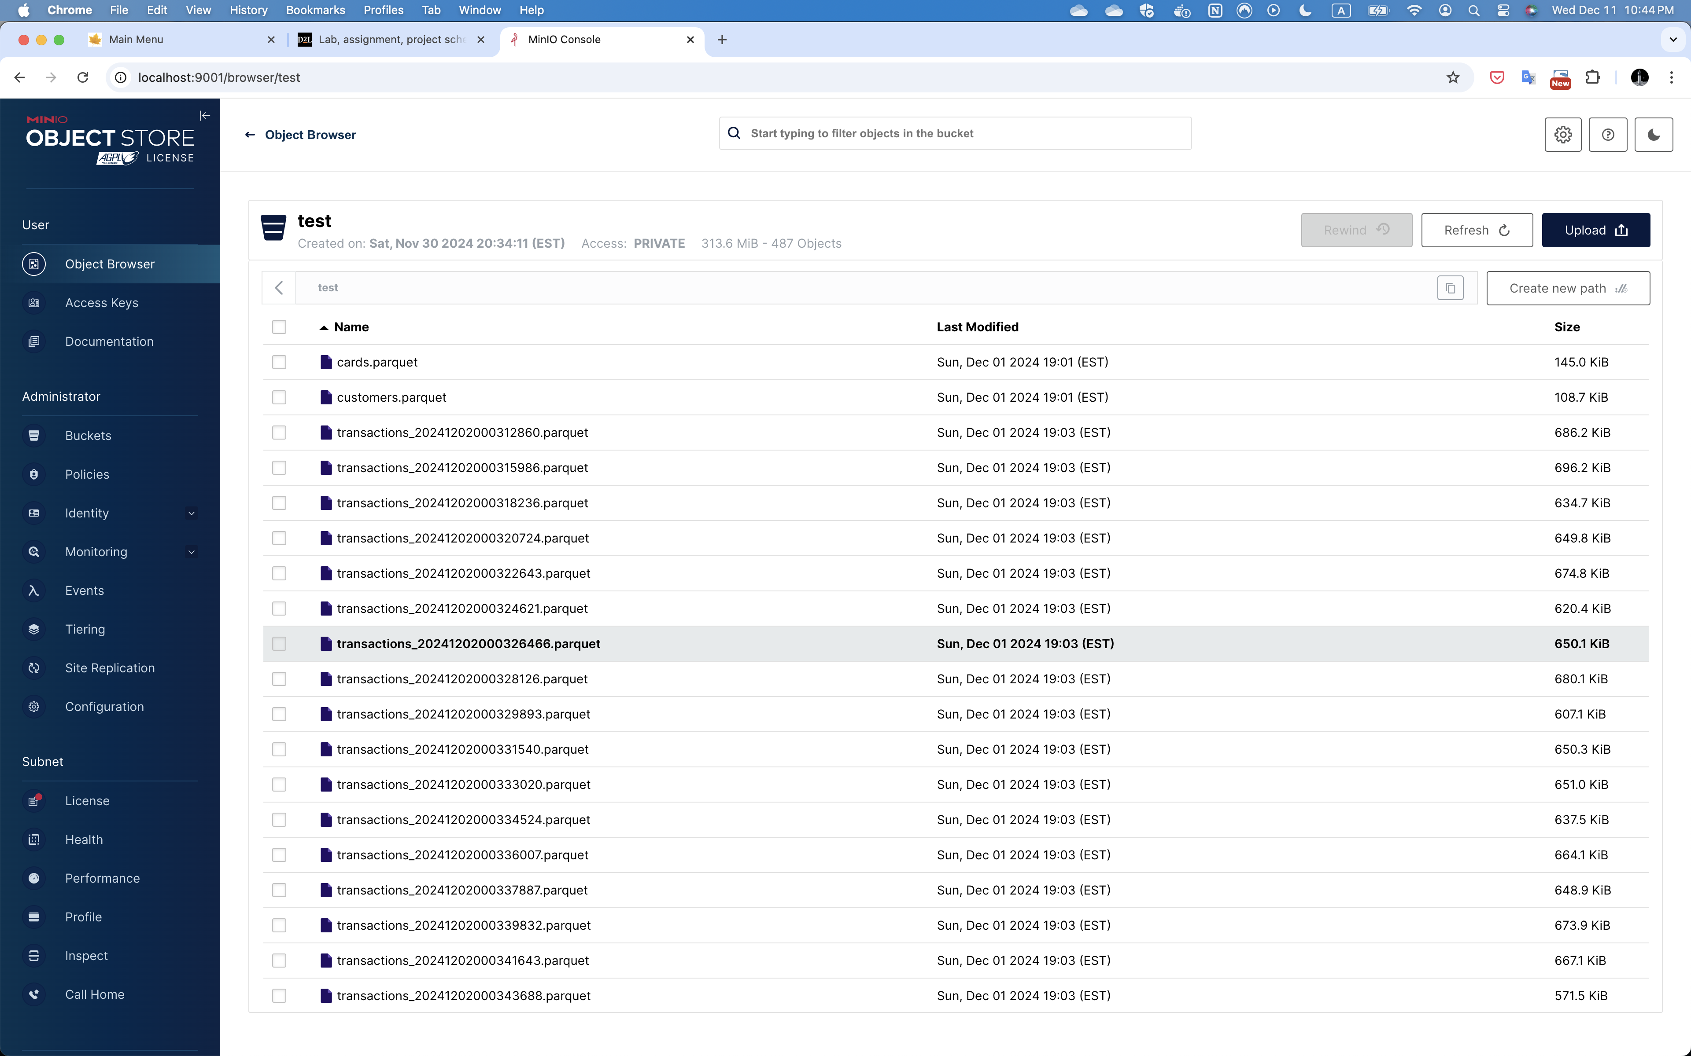
Self-hosted Object Storage

Slide 20
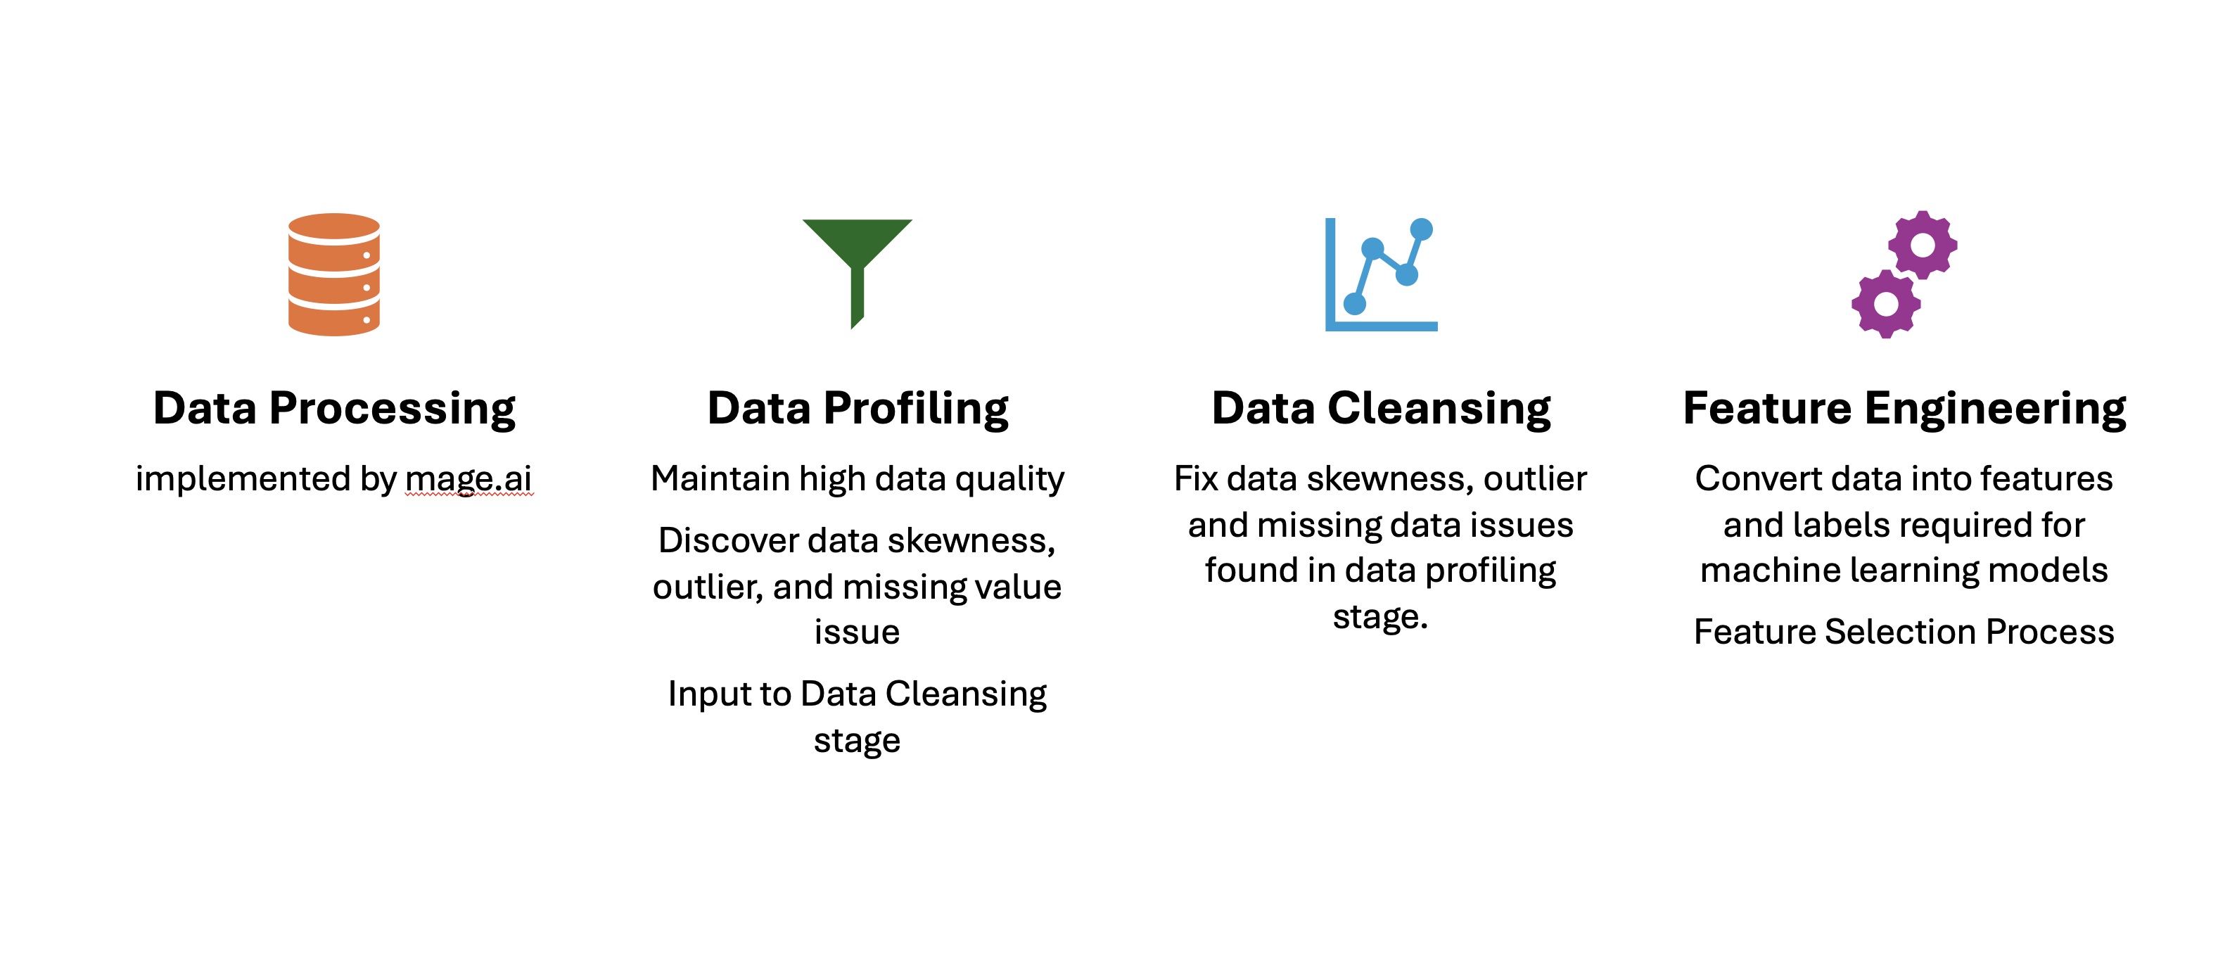
Data Pipeline

Slide 21
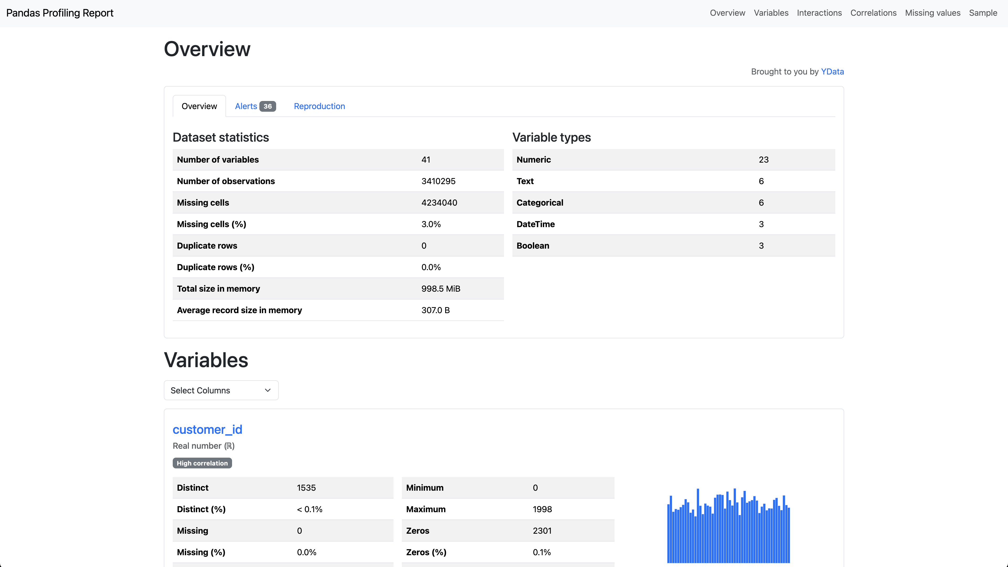
EDA Analysis Framework
Missing Values - By using EDA it is possible to find columns with missing values. In this regard, you will probably replace or rather remove them depending on what proportion of values were not found.
Outliers - In case there are outliers in your data, performing EDA can help you to detec them. Such cases differ greatly from other observations. These strange values might be true or erroneous.
Distribution of Data - When one does exploratory analysis of data, he/she can understand its distribution too well. If it’s skewed, then it might not work as expected by some machine learning algorithms.
Correlation - Furthermore, through conducting EDA on your dataset you can also determine if there are any correlated features among them which will lead multicollinearity among linear regression models if they have highly correlated features.
Constant Features - Moreover, one may equally use this step to determine if there are any constant features in dataset that lacks useful information hence, they need to be deleted as well.
Categorical Variables - Additionally, when engaged in exploratory analysis of data one may also find out how many categorical variables exist and their distinct categories too since a few categories might have minimal counts thus requiring special treatment separately.
Feature Magnitude - Furthermore another thing that comes into the picture during EDA is whether the different measures are being used for scaling features for such algorithms like learning machines where scale needs to be uniform across all these arrays.

Slide 22
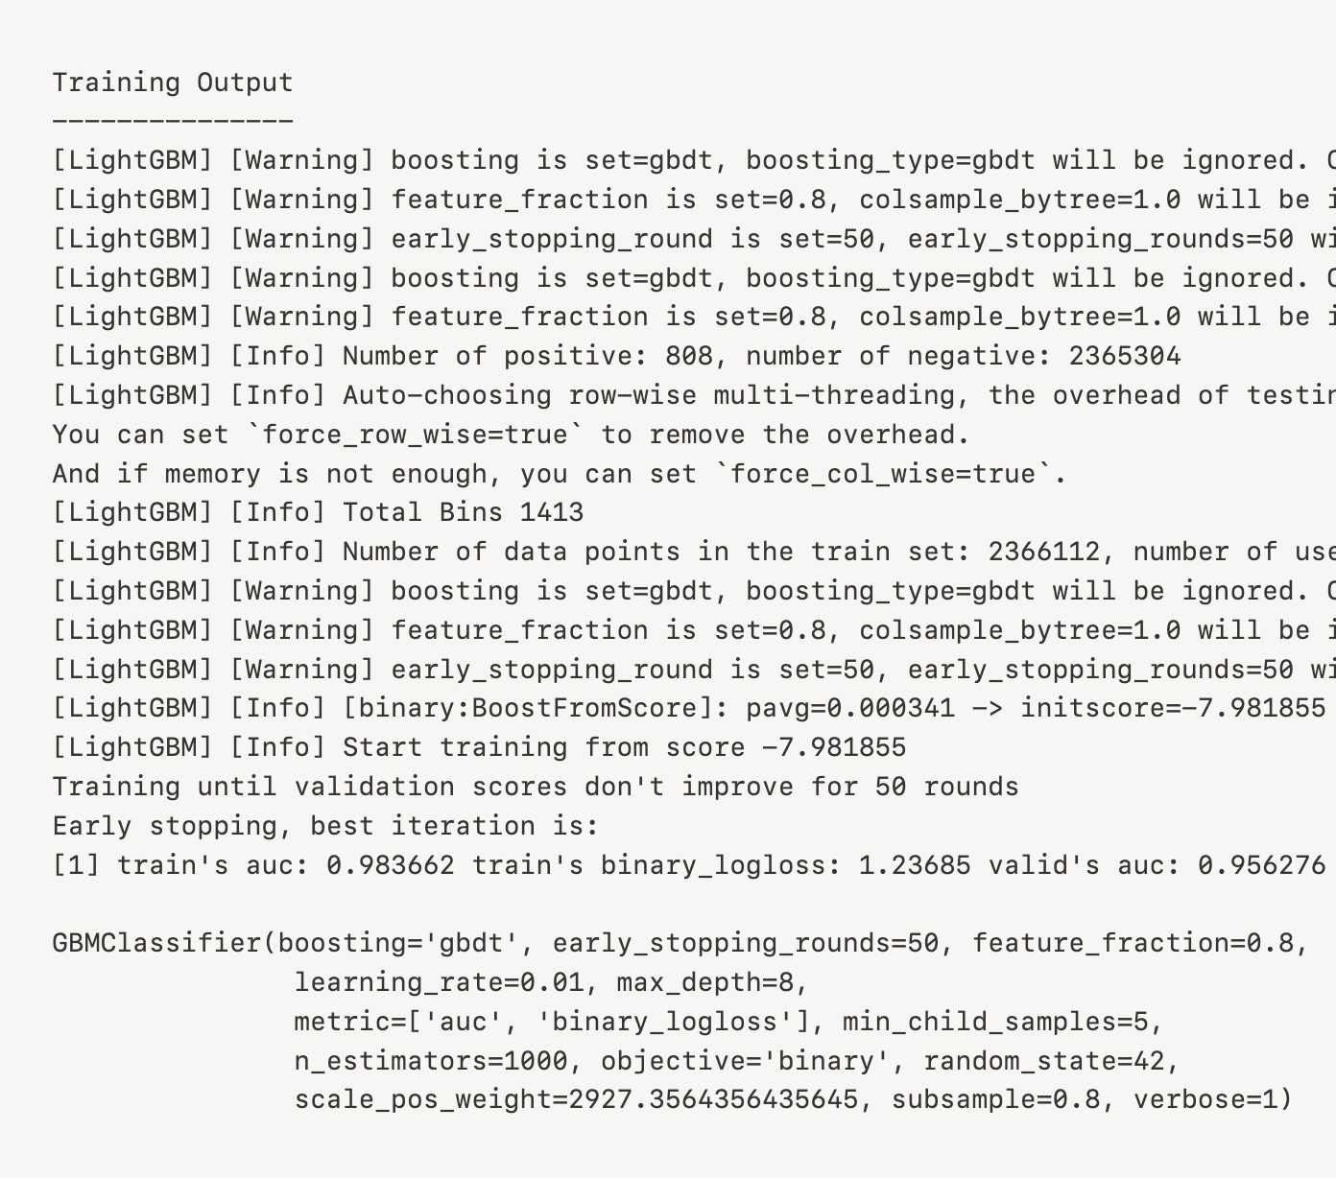
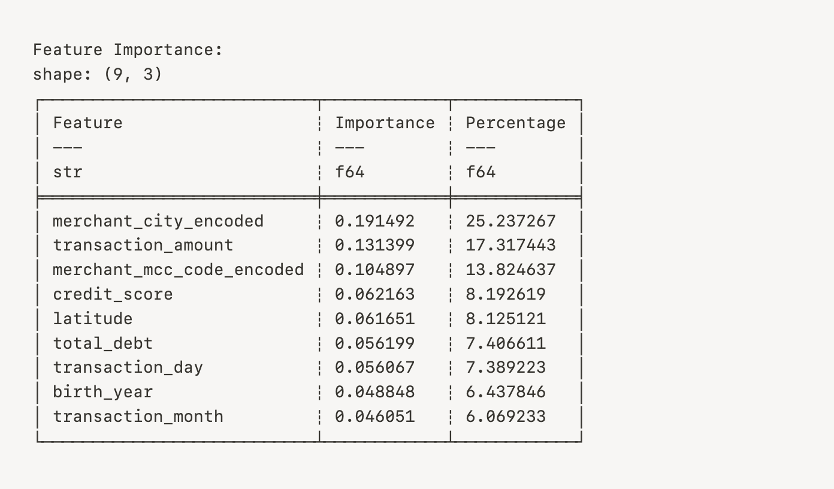
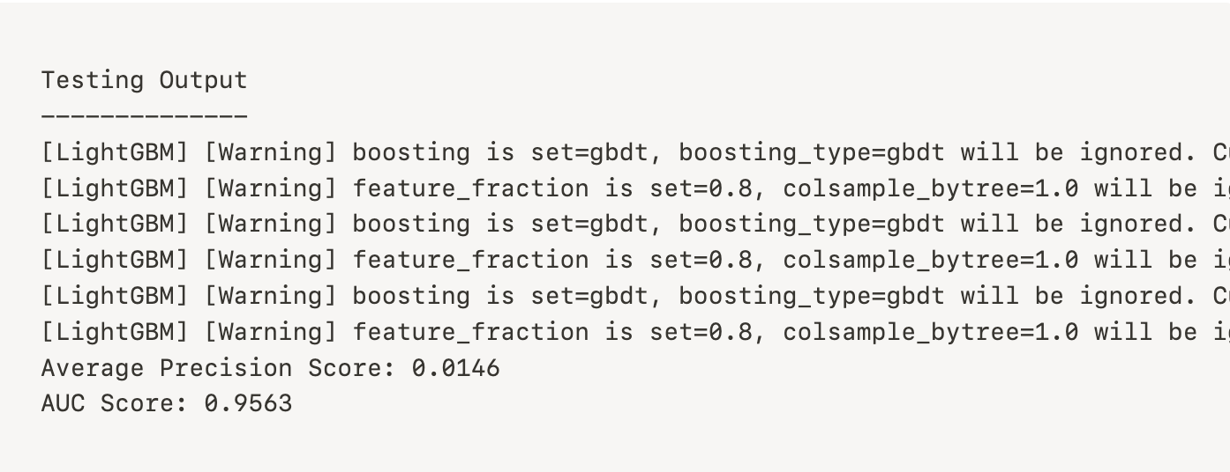
Model Training and Testing
The AUC indicates the chances that, when showing the model a positive and negative token at random, it will place the positive token in a higher rank, if given a mildly better model which attaches a unit length square with vertices at p=1, AUC=1.0. Hence it can be asserted that the chances of the model disregarding a random negative token while accurately classifying a random positive token is 100%.

Slide 23
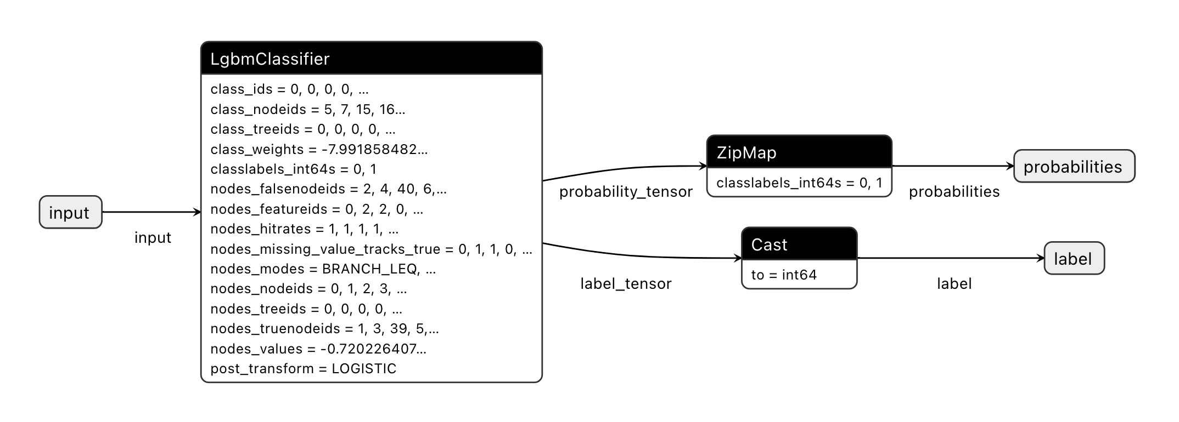
Microsoft ONNXRuntime

Slide 24

Thank You

